Slide 1
What’s the point in (a) history? One local librarian’s journey into an institution’s past
M.K.K. Hague-Yearl (she/her/elle)
Head Librarian, Osler Library of the History of Medicine
mary.yearl@mcgill.ca

Slide 2
Acknowledgements
McGill University is located unceded Indigenous lands. We honour, recognize and respect the Kanien'kehá:ka Nation as the custodians of the lands and waters on which we are meeting. We also recognize that Tiohtià:ke/Montréal has long been a meeting place for many First Nations and today it is home to a diverse population of Indigenous and other peoples. We respect the continued connections with the past, present and future in our ongoing relationships with Indigenous and other peoples within the Montreal community.
The university’s founder, James McGill, enslaved at least five Black and Indigenous people: Sarah, also known as Marie-Charles and Charlotte (c.1763-1809), Marie-Louise (c.1763-1809), Jacques (c.1760-1838), Marie Potamiane (c.1773-1783), and a boy thought to be Chatiks si chatiks (Pawnee) (c.1768-1778) whose name is not recorded.

Slide 3
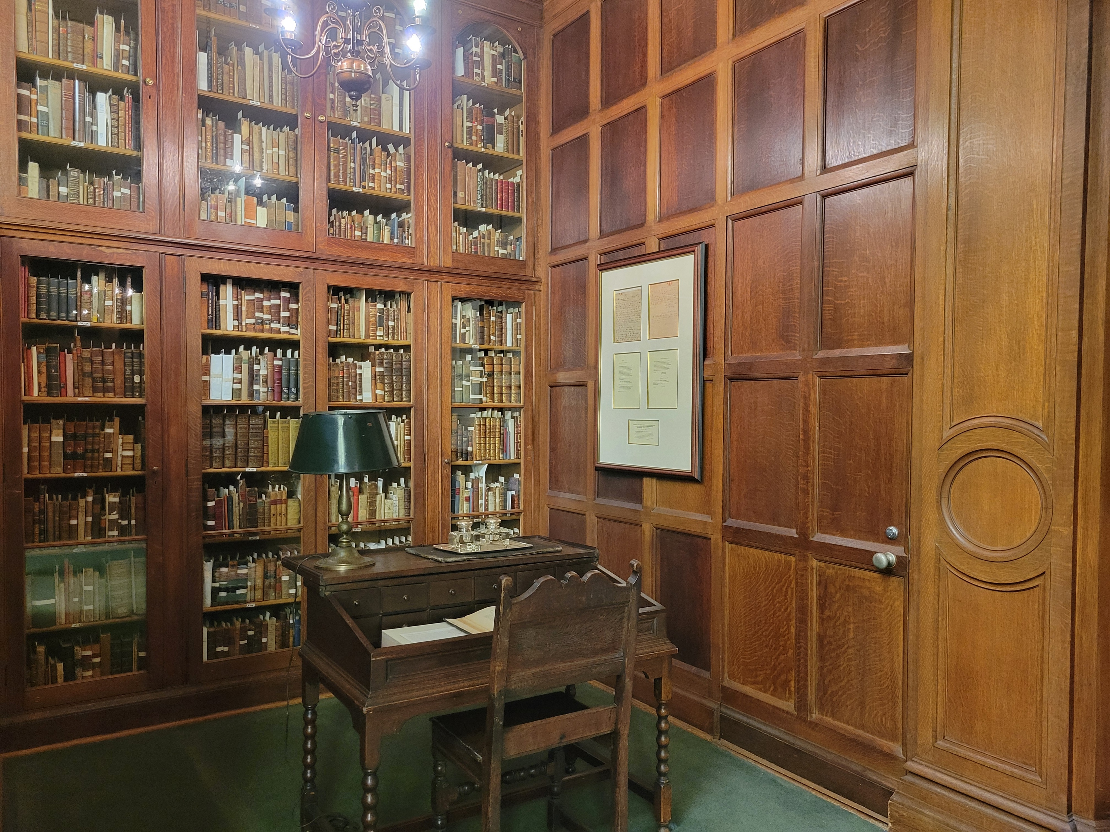
Acknowledgements continued: design is important
“Special collections reading rooms inherited by research libraries across the Western world were designed for white men. Even as the existence of some of these spaces predate constructions of white masculinity as we understand them today, their interiors—rooted in the visual language of power and colonialism—have contributed to the processes by which those constructions have been formed.”
— Jesse Ryan Erickson, “The Gentleman’s Ghost: Patriarchal Eurocentric Legacies in Special Collections Design,” in Mary Kandiuk, ed., Archives and Special Collections as Sites of Contestation (2020)

Slide 4
Plan
I. Background: a library long in the making
II. The Francis years
III. Post-Francis
IV. Thoughts and conclusions: the next 100 years

Slide 5
I. Background: a library long in the making
Counsels and Ideals from the Writings of William Osler (Oxford, 1905)
Quoting William Osler, “Books and Men,” Boston Med Surg J, 1901

Slide 6
A gift in progress
Deed of gift, William Osler
1 October 1911
Legal Papers, Box 118, P100

Slide 7
Early development, as told in “The collecting of a library”
McGill (1874-1884)
To the BO: few textbooks, ”some special treasures like Virchow’s ‘Gesammelte Abhandlungen’” [BO 1629]
To McGill’s Medical Library, Canadian medical and scientific journals
Philadelphia (1884-1889)
“I became associated with a first-class medical library” [Coll of Phys.]
“My library grew rapidly, and important German and French sets were completed. … [M]y interest in the American masters…[BO 3097, 3454] were picked up…”
“1,000 volumes, chiefly journals which I knew were in Baltimore, were distributed to various libraries.”
Notes:
pp. xix-xxi, “The Collecting of a Library”

Slide 8
A career in medicine, a career in book-collecting (more from “The Collecting of a Library”)
Johns Hopkins (1889-1905)
“With a bigger salary and increasing income I began to buy, first, the early books and pamphlets relating to the profession in America; secondly, the original editions of the great general authors…. Catalogues…appeared at the breakfast table, and were always in my bag for railway reading.”
“Buying freely English and foreign books and subscribing to more than forty journals, I soon had the house overrun, but with special exceptions they were passed on to my friends or to libraries.”
“When I left Baltimore…sets of journals, monographs, and many works on general literature were distributed among friends and libraries. A good beginning had been made in an attempt to get the original editions of the great authors in medicine. The Sir Thomas Browne collection was nearly complete.
Oxford (1905-1919)
“Oxford brought two thing–leisure and opportunity.”
Notes:
pp. xxi-xxiii “The Collecting of a Library”

Slide 9
A library needs a focus
William Osler to Casey Wood, item 85, folder 113, P417

Slide 10
Refining the terms
William Osler, “Bibliotheca Osleriana (memoranda relating to),” 24 March 1919,
Legal papers, Box 110, P100

Slide 11
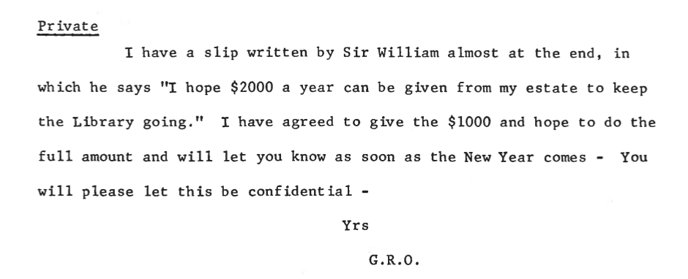
A vision partially fulfilled
William Osler
“Changes in the will”
326/17, Box 110, P100
G. R. Osler to H. S. Birkett
February 12 [1920]
326/1.5, Box101, P100

Slide 12
Grace Revere Osler interprets Sir William Osler’s vision
Arthur Currie to Nobbs re: Grace Revere Osler’s feedback
14 November 1921, 326/45/2, Box 118, P100
Osler Library sketches (1922-23)
Nobbs Archive, John Bland Canadian
Architecture Collection, McGill Univ.

Slide 13
Thought experiment: what if Charles Singer had been the first Osler Librarian?
326/45/1, Box 118, P100
Above: Charles Singer to S. E. Whitnall,
30 July 1921
Left: Whitnall to Singer, 8 December 1920

Slide 14
II. The Francis years : the Osler Library as a shrine
“Someone…may protest that to have a shrine a man must have been a saint. … Osler, indeed, was canonized in 1896 by the pope of medical artists, Max Broedel, in the delightful caricature which many of you must have seen.”
— W. W. Francis, “At Osler’s Shrine,” Bulletin of the History of Medicine 26 (October 1937), 1.
“This is a shrine to him. His ashes are behind this panel. He was cremated, and wanted to be buried with his books. So we have put his own writings in these two cases to the left and his favourite authors to the right.”
— W. W. Francis, “Showman’s Patter: A Description of Books in the Osler Library, Dictated by the Author, 1950-1957,” 1957.
“First, [the Osler Library] represents the lifelong avocation of a remarkable man. It serves as a shrine for the large number of physicians and laymen who continue to respect Osler’s memory.”
“The Osler Library in 1929 was Osler’s library. Now it represents much more than that.”
— Charles Roland, “The Osler Library. McGill University,” JAMA vol. 200, no. 10. June 5, 1967. Pp. 161-166.
Max Brödel, “The Saint – John’s Hopkin’s Hospital,” 1896. Osler Library, Osler Photo Collection, CUS_046-007B_P

Slide 15
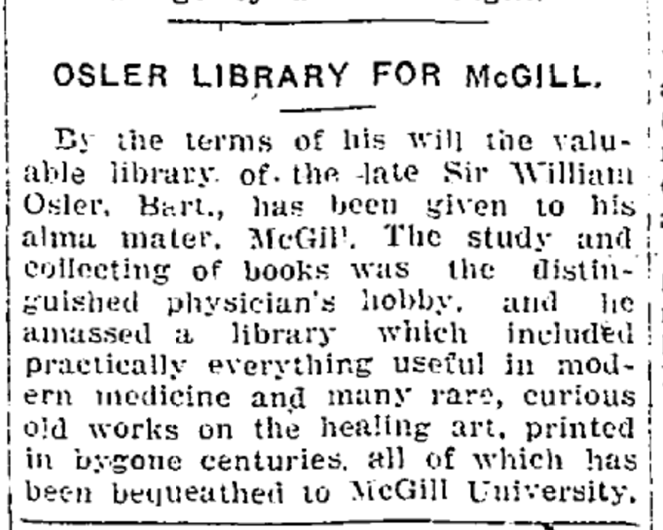
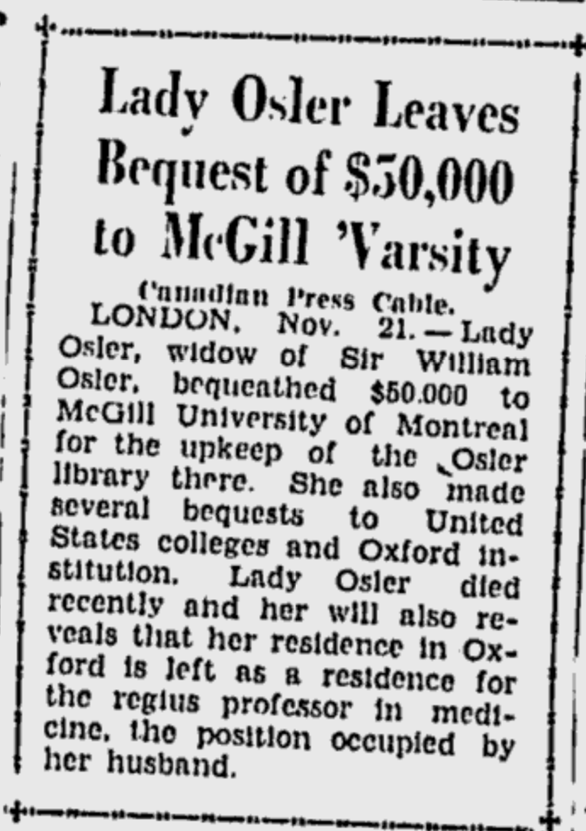
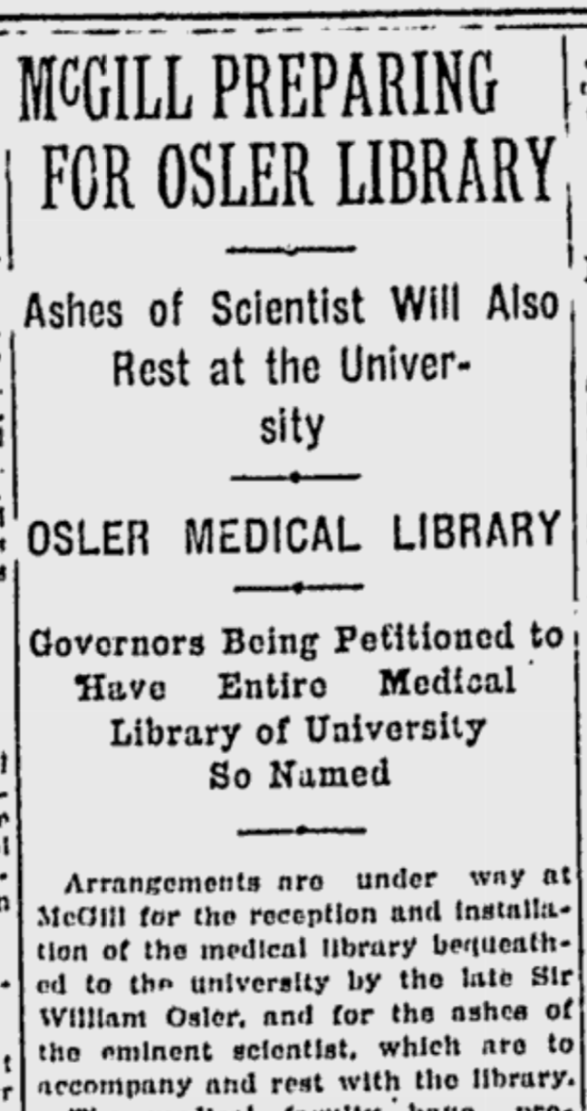
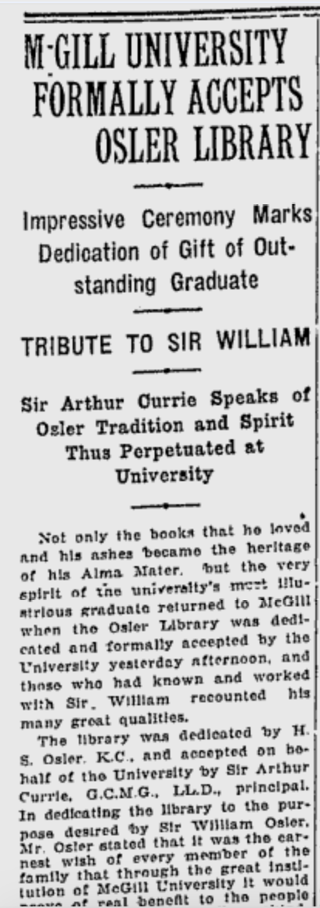
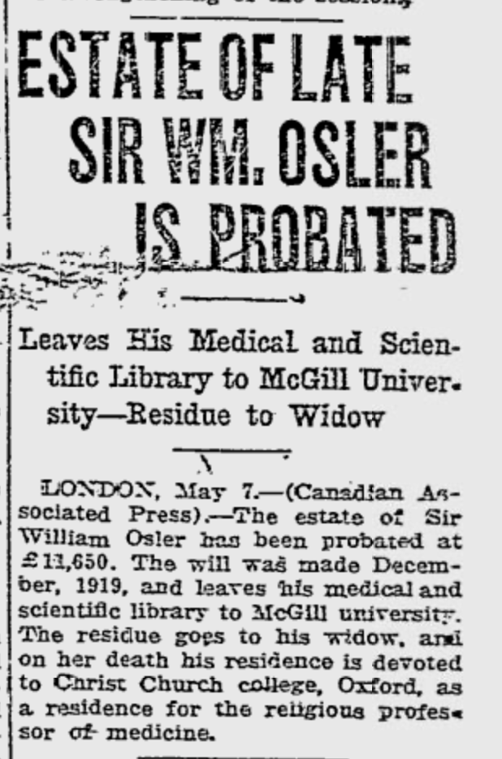
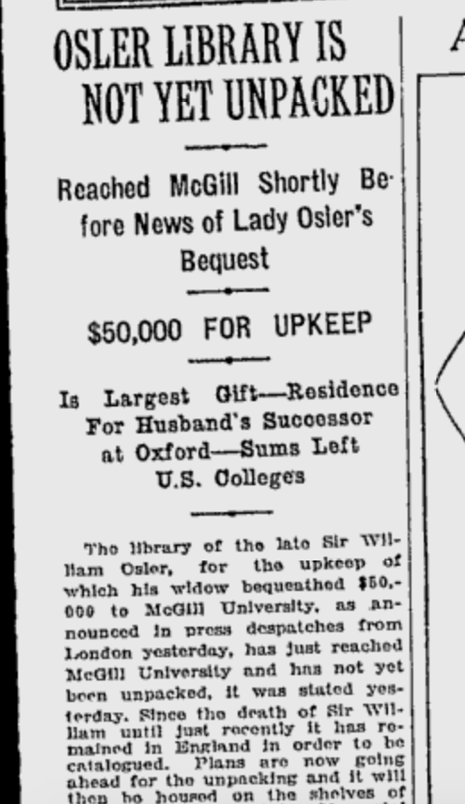
The Osler Library as a news item
Toronto World, 20 Jan 1920
Ottawa Evening Citizen
21 Nov 1928
Gazette
15 March 1921
Gazette, Women’s page
22 Nov 1928
McGill Daily
9 Jan 1929
Gazette, 30 May 1929
Morning Leader (Regina)
8 May 1920

Slide 16
Sir Arthur Currie, Principal of McGill, at the library’s opening
“In this Osler Library are the books his hands touched daily with affection as one touches a beloved child; here are the pages his eyes perused with eagerness in the search of knowledge or of strength; here are the gallant comrades of his hours of toil, while the heedless world rolled by; here are the companions of his moments of recreation and his brief periods of respite from labor. Surely these books are a sacred treasure, which will give daily to our students and professors a closer contact with a great spirit and will bring them, at their will, into a glorious company of immortals of whom their own great but humble fellow graduate was an honored member. There could be no greater inspiration to Canadian youth than this splendid and sacred gift which is ours today.”
[emphasis mine]

Slide 17
Why McGill?
“Though a wanderer living away from Montreal for more than half my life, I have never forgotten the early associations. The formative years were there with the strong ties of head and heart. As a young, untried man, McGill offered me an opportunity to teach and to work; but what is more the members of the medical faculty adopted me, bore with vagaries and aggressiveness and often gave practical expressions of sympathy with schemes that were costly and of doubtful utility. That they believed in me helped to a belief in myself, an important asset for a young man, but better had by nurture than by nature. Alma Mater, too, counts for much, and as a graduate of McGill I am proud of her record…”
— William Osler, “The Collecting of a Library,”
Bibliotheca Osleriana (Oxford, 1929).

Slide 18
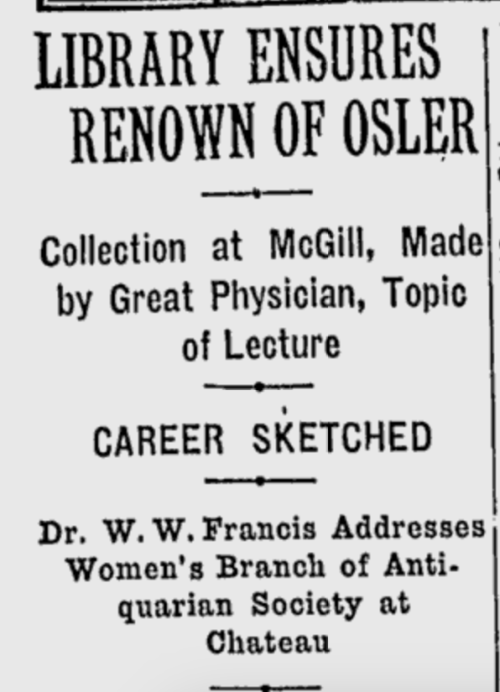
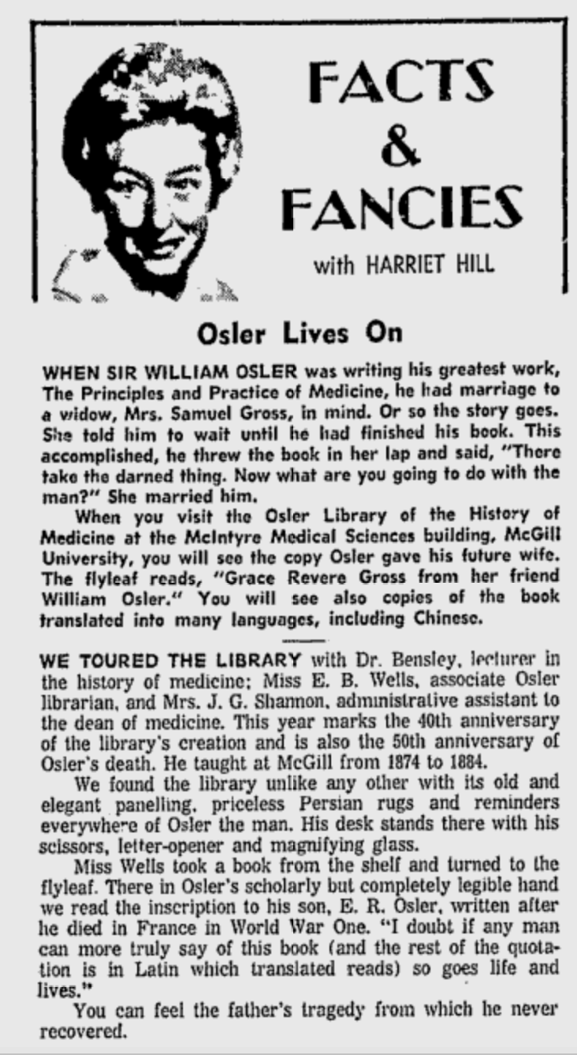
Years, decades, later, still newsworthy (locally, at least)
Gazette, Women’s page
20 Dec 1933
Gazette, Women today
29 Jan 1969
Gazette, 17 Feb 1936

Slide 19
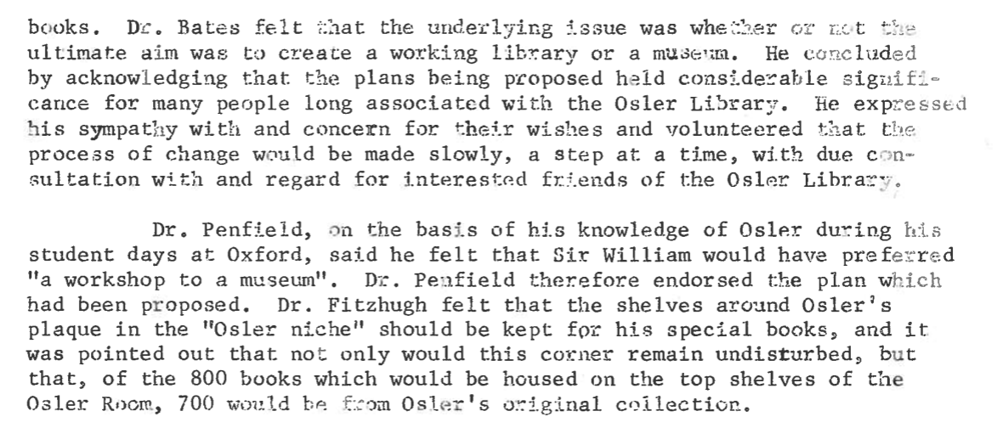
III. Post-Francis, new interpretations
Minutes, Osler Library Board of Curators, 5 April 1967

Slide 20
Major changes that reflect new directions
Impetus for change
Passing of W. W. Francis (1959)
Move of the Osler Library to the McIntyre Medical Building
Funds from the Wellcome Trust and from the Markle Foundation
Department of History of Medicine (later Social Studies of Medicine)
Change on the ground
Revision of governance documents
Integration of books
Emphasis on collection development
Osler Room from shrine to reading room and back again

Slide 21
50th anniversary: focus on bibliography, scholarship
Charles Roland (McMaster), “‘Dry, Dusty, Tedious, Accursed, Hateful Bibliography’: Osler and British Bibliography”
Richard J. Durling (Kiel), “Medico-Historical Research in Mediaeval and Renaissance Manuscripts”
Estelle Brodman (St. Louis), “Looking Forward into Historical Medical Bibliography”
G. Thomas Tanselle (Guggenheim Foundation), discussion of bibliography
Eric Freeman (Wellcome), “Medical Historians, Librarians and Bibliographers: Will They Ever Meet?”
Osler Library Newsletter
No. 32 (October 1979)

Slide 22
With an emphasis on growth, statistics matter
From the basics, as recorded on the eve of the library’s 50th anniversary, comparing figures to those of 1931…
Osler Library Newsletter, No. 31 (June 1979)

Slide 23
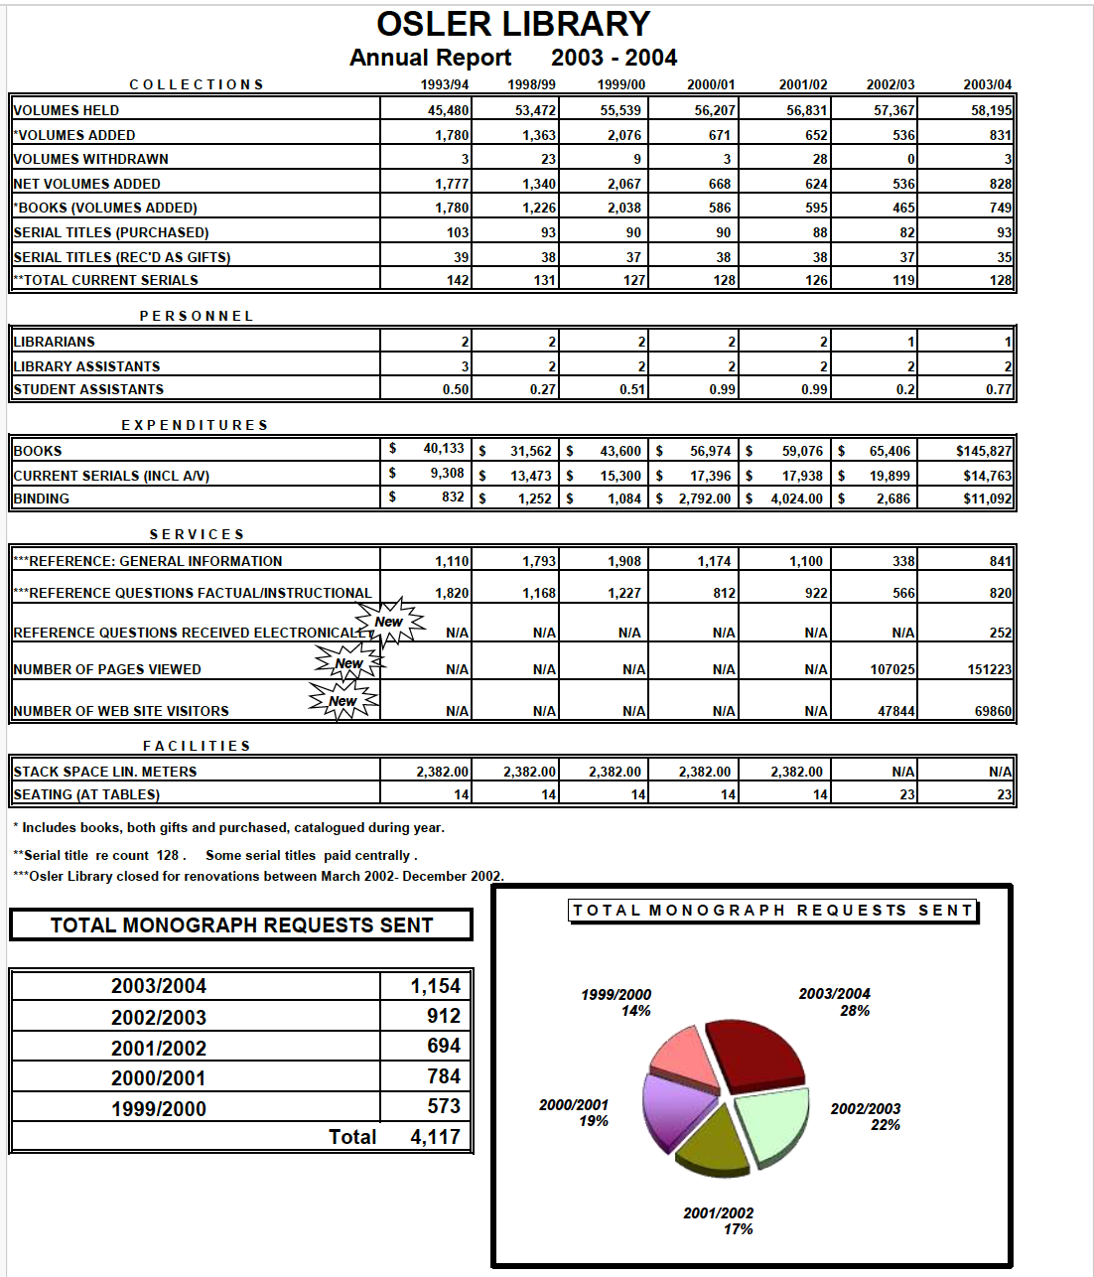
… to a full statistical statement
on the occasion of its
75th anniversary

Slide 24
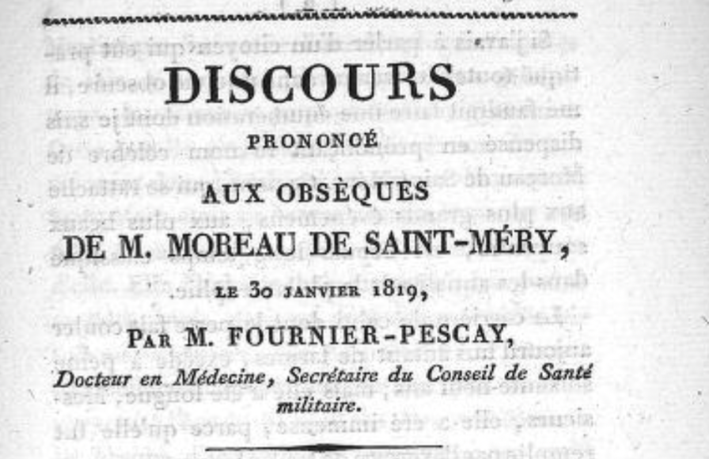
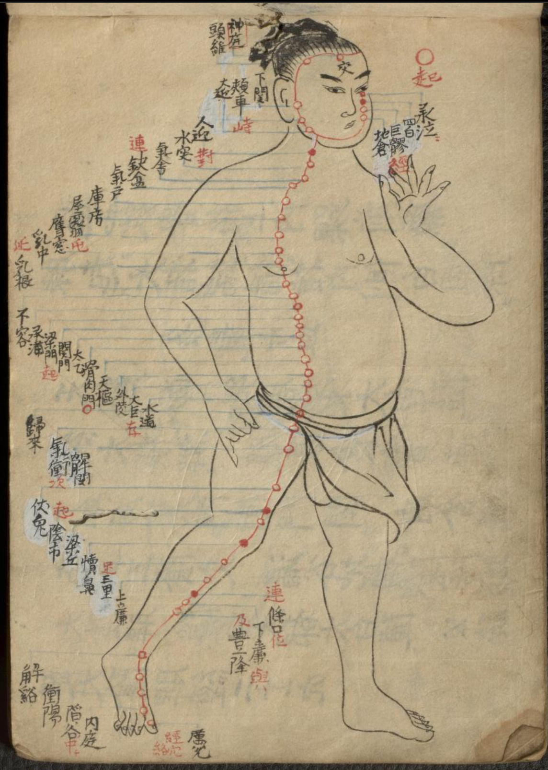
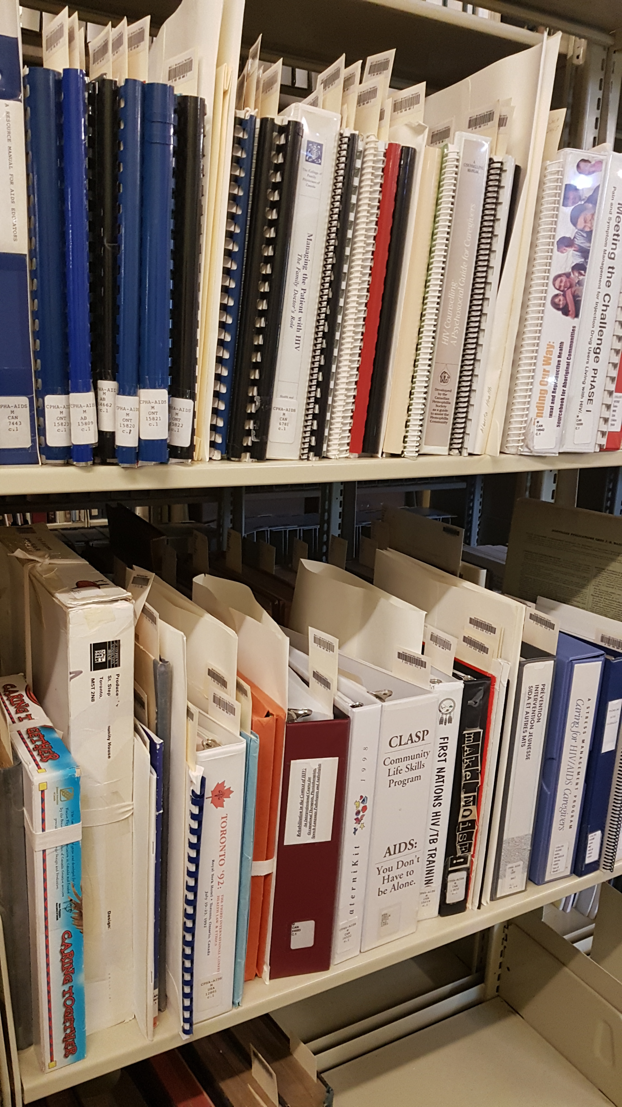
Recent collection development
Canadiana (especially health care in Quebec)
Archival collections of Canadian (particularly Quebec) practitioners
A world beyond Europe, the United States, and Canada
Deaccessioned works
from the CATIE library
François Fournier-Pescay
(in cataloguing, image from IA)
Jūshi keiketsu uta, ca. 1800

Slide 25
One curator’s vision (2007)
Responses to Wellcome Library Benchmarking 2007 Qualitative Questionnaire
8.10, Surveys and comments on the Library, P230

Slide 26
Staffing: a challenge in every age?
Response to patron complaint, 17 December 1996
8.10, Surveys and comments on the Library, P230
The wish of a retiring librarian, 2011.

Slide 27
IV. Thoughts and conclusions
“A library represents the mind of its collector, his fancies and foibles, his strength and weakness, his prejudices and preferences.”
— William Osler, “The Collecting of a Library,” Bibliotheca Osleriana (Oxford, 1929).

Slide 28
Thank you!
Grace Revere Osler ca. 1912
CUS_090_005

