Slide 1
Quantitative Methods for Assessing eBook Frontlist Use at a University Library
Emma Clarke and Meredith Giffin
Concordia Library Research Forum
April 25, 2025

Slide 2
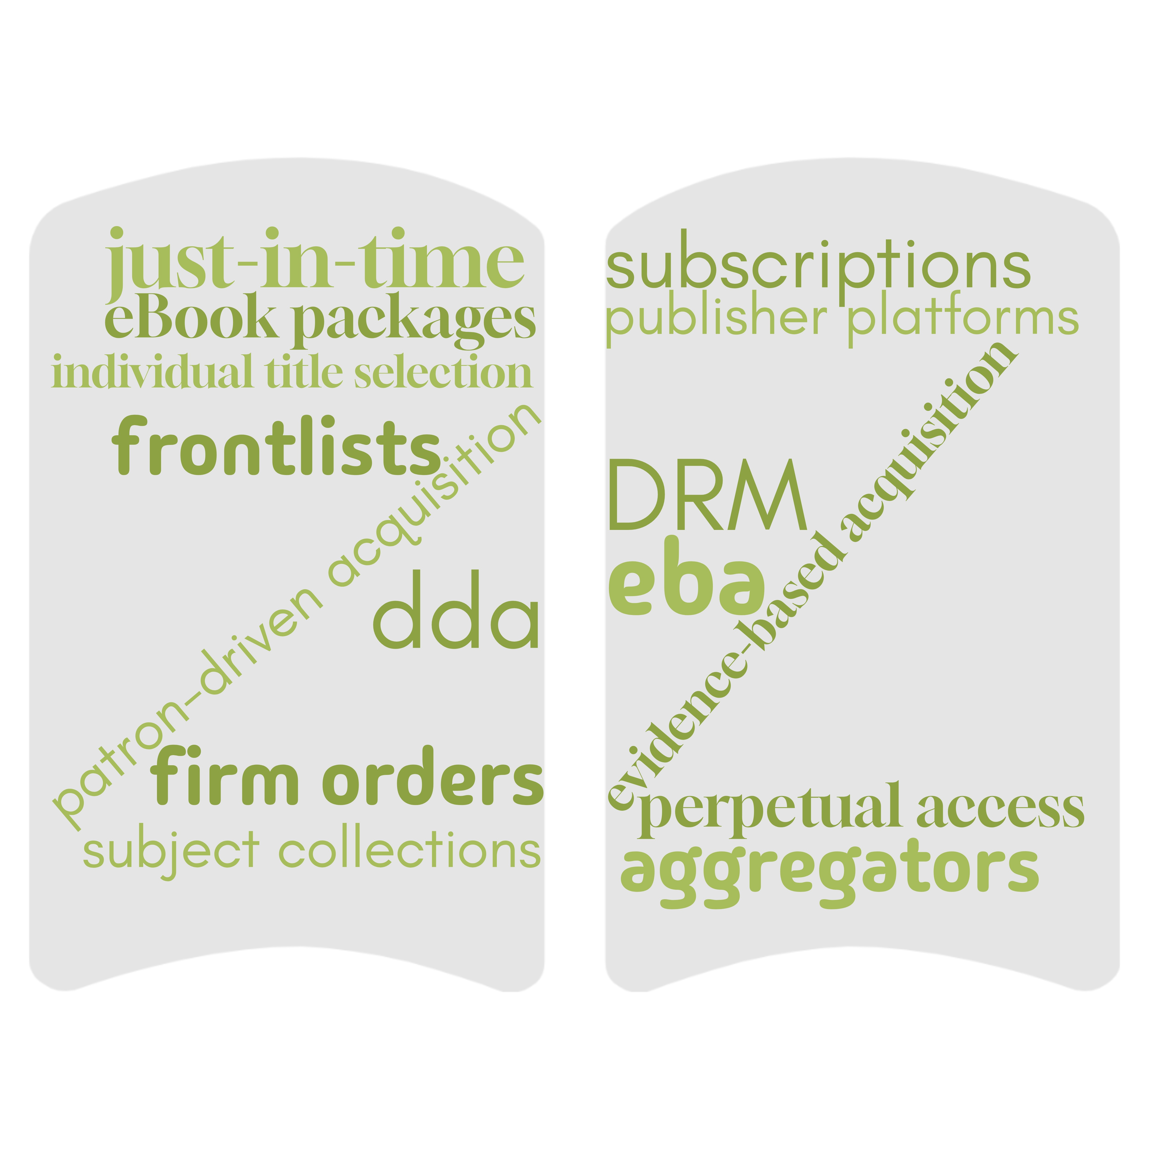
eBook acquisitions @ Concordia Library
>1 million eBook titles
Significant increase during/since COVID-19 pandemic
Multiple platforms
Multiple acquisition models

Slide 3
eBook frontlists Purchasing forthcoming titles in a subject area/from a provider for that year
Advantages
Efficiency
Timely access to new titles
DRM-free
Discounts
Low cost per title
Disadvantages
Committing large spend
"Just in case" acquisition
Can't predict pertinence of new titles

Slide 4
Assessing eBook frontlist purchases
Budget constraints
Multiple subjects on several provider platforms
Discounts don't always mean good value
Similarity to book approval plans and journal "big deals"

Slide 5
Evidence-based assessment
eBook assessment literature review
Comparisons:
Between different vendor packages
Of packages to single-title selection to DDA/PDA and EBA
Multiple methods discussed:
Usage
Usage over time
Cost per use
Percentage of titles used
Title usage details

Slide 6
Longitudinal analysis of thematic eBook collection usage across various publisher platforms

Slide 7
Longitudinal analysis of frontlist A's usage

Slide 8
Frontlist A: Usage by title

Slide 9
Frontlist B: Usage by title

Slide 10
Percentage of frontlist A used

Slide 11
Cumulative use of frontlist A
"If this figure remains low, even several years out, then individual title selection might make more sense for a library. Conversely, a high figure would suggest that the savings in time and money by purchasing the collection in its entirety would outweigh the fact that some titles were never used."
Lener & Moulton (2017)

Slide 12
Longitudinal analysis of frontlist A's cost-per-title

Slide 13
A closer look at frontlist A's cost

Slide 14
Next steps
Examine thematic collections with:
Consistent frontlist purchases
Increasing costs
Low % of frontlist used
Post-assessment considerations:
Ceasing frontlist purchase
Other acquisition models from that provider, or a provider in the same discipline (e.g., an EBA)

Slide 15
Bibliography
Carrico, S. B., Cataldo, T. T., Botero, C., & Shelton, T. (2015). What Cost and Usage Data Reveals About E-Book Acquisitions: Ramifications for Collection Development. Library Resources & Technical Services, 59(3), 102–111. https://doi.org/10.5860/lrts.59n3.102
Fry, A. (2019). Ebook Rate of Use in OhioLINK: A Ten-Year Study of Local and Consortial Use of Publisher Packages in Ohio. College & Research Libraries, 80(6). https://crl.acrl.org/index.php/crl/article/view/23530/30839
Goertzen, M. J. (2017). Applying Quantitative Methods to E-book Collections. Library Technical Reports, 53(4), 1–31. https://doi.org/https://doi.org/10.5860/ltr.53n4
Lannon, A., & McKinnon, D. (2013). Business E-books: What Can Be Learned From Vendor Supplied Statistics? Journal of Business & Finance Librarianship, 18(2), 89–99. https://doi.org/10.1080/08963568.2013.767121
Lener, E., & Moulton, M. (2017). Taking the Long View: A Case Study of E-Book Usage at a Comprehensive Research University. Charleston Conference Proceedings, 2017. Charleston Library Conference. https://doi.org/https://doi.org/10.5703/1288284316656
Sprague, N., & Hunter, B. (2008). Assessing e-books: Taking a closer look at e-book statistics. Library Collections, Acquisitions, & Technical Services, 32(3–4), 150–157. https://doi.org/https://doi.org/10.1080/14649055.2008.10766213

