Slide 1
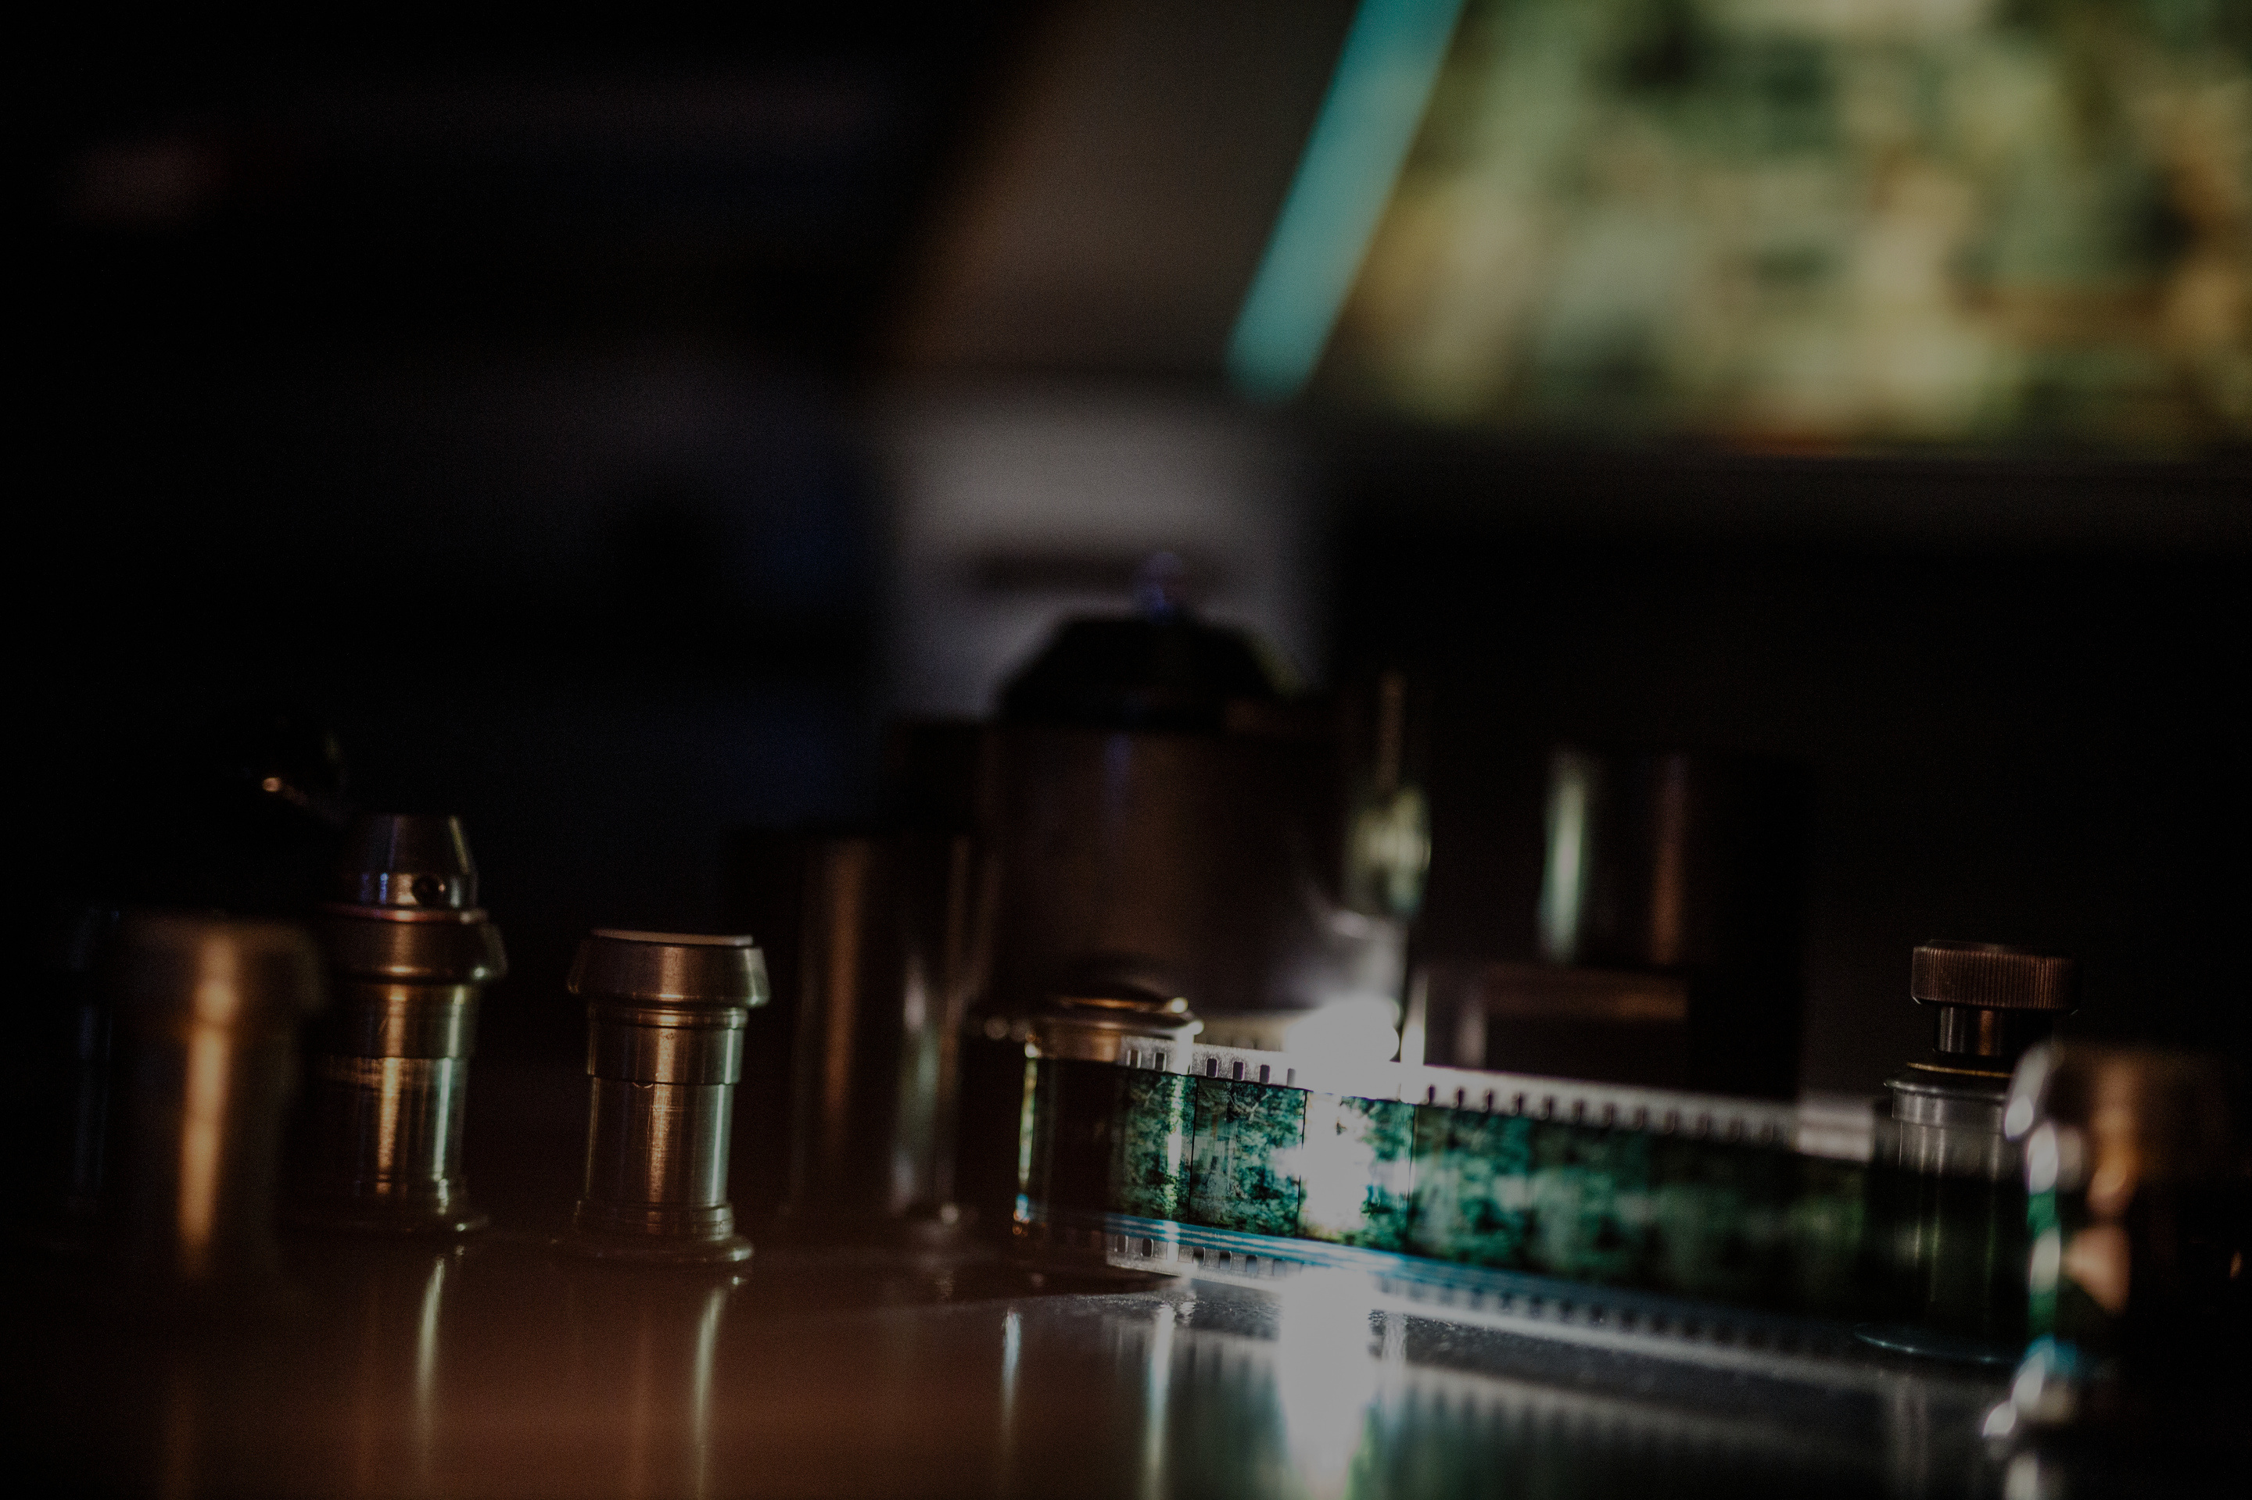
Visual Media at
Concordia University:
Managing Physical Media Collections for Film Studies in the Digital Age
Kathleen Botter, kathleen.botter@concordia.ca
Hélène Brousseau, helene.brousseau@concordia.ca
Andréa Harland, andrea.harland@concordia.ca
Library Research Forum 2025

Slide 2
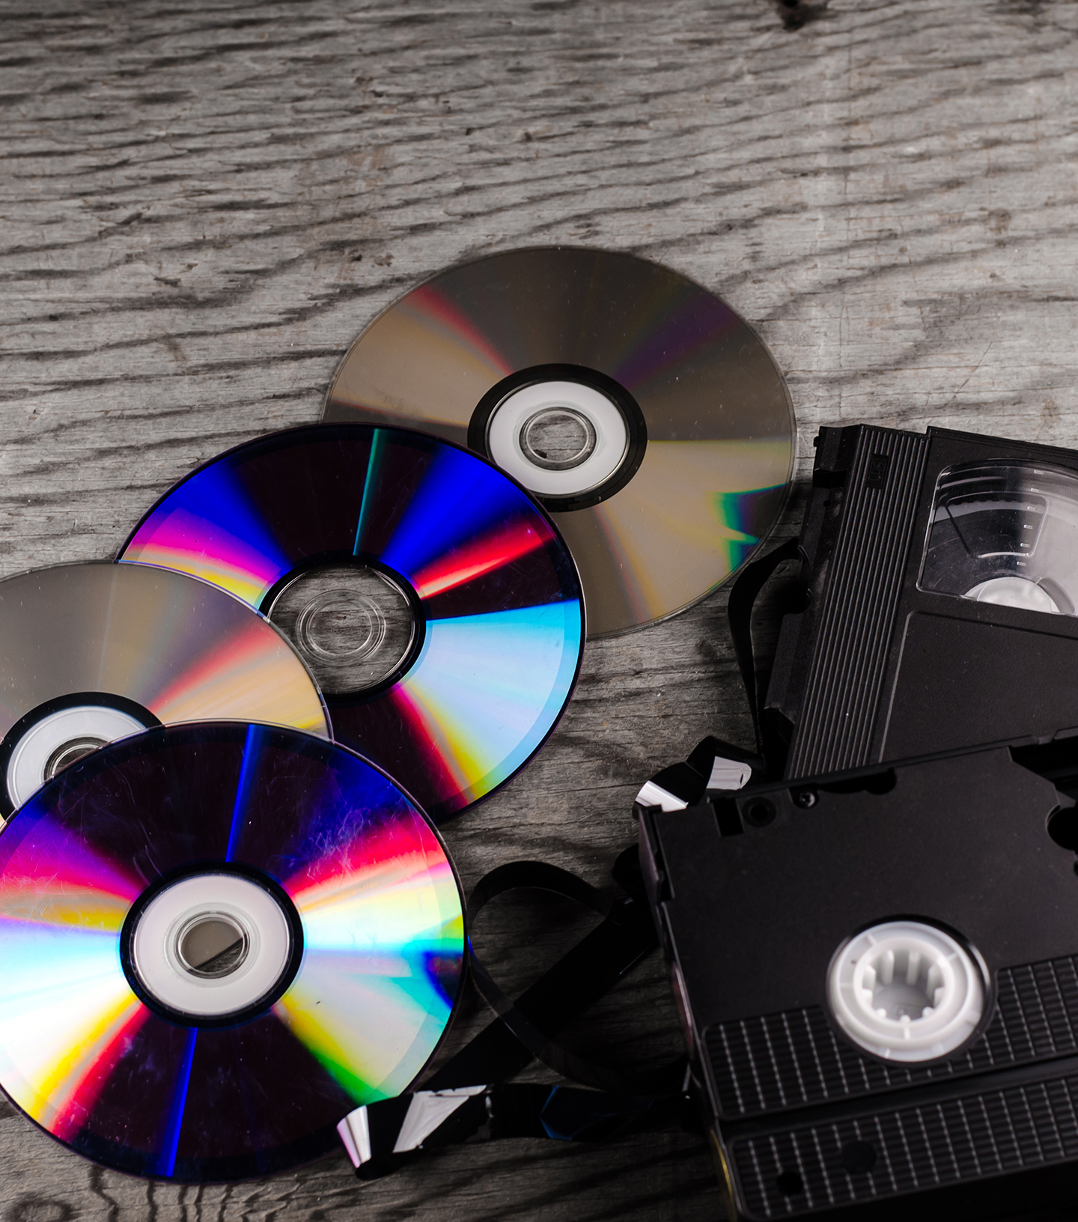
What we will be covering today
Literature review
A case study example: Concordia Library and the Visual Collections Repository (VCR)
What the faculty says
Next steps with the research project

Slide 3

Literature review
“While streaming media has been used by academic libraries for some time now, the literature on this topic. . . is still emerging post-pandemic. What is more, it can become dated very quickly.”
(Fullmer, 2023, p. 60)
Focus is on:
Physical formats for film, particularly DVDs and Blu-ray, versus streaming
How film studies instructors use these collections
Providing access to these formats in academic settings

Slide 4

Why is physical media still with us?
“. . . the business practices of distributors that have shifted from retailing physical media to offering subscription-based, time-limited access to digital files usable only on proprietary platforms without the option of physical or durable digital download formats.” (Smith et al., 2024, p. 3)
“. . . much of this content is not otherwise available. . .” (Benedetti, 2024, p. 106)
Streaming access can be problematical
Some films are not available in other formats
Viewing quality may be more controllable
Access may be more reliable
Managing copyright questions may be more straightforward
May give access to special content
“This means that video-on-demand is not the same as cinema, nor is it the same as watching a film on DVD or on television. Even beyond the image and sound design, some aspects that may be of interest to film studies are lost in the streaming of media.” (Hagener & Kammerer, 2020, p. 469)
“Even if a streaming video package offers institutional access and relevant films, titles may disappear from the package at any time. . .” (Rodgers, 2018, p. 569)
“DVDs offer tangibility, viewing quality, and relative legal simplicity” (Rodgers, 2018, p. 582)

Slide 5
Challenges and benefits of physical media
“With physical space at a premium, collection analysis is critical. Without resources to warehouse collections that no longer serve a purpose, we evaluated and weigh our physical collections for curricular need and usefulness.” (Benedetti & Cross, 2024, p. 105)
“Watching the film during class was ranked as the most preferred method by nearly half of students [surveyed]. . .”
“The need for better screening space on campus was raised by faculty and librarians. . . “ (Rodgers, 2018, p. 583)
Require shelving space
Purchasing is not always straightforward
Newer films may never be available on older formats
Requires special equipment and spaces for viewing
May meet pedagogical needs of instructors
May sometimes be more affordable option
Currently easier format to share between libraries
“. . . [online streaming] is both a blessing and a curse.”
“For a scholarly discussion, however, you need stable and guaranteed access, text-critical editions and easy handling” (Hagener & Kammerer, 2020, p. 472)

Slide 6
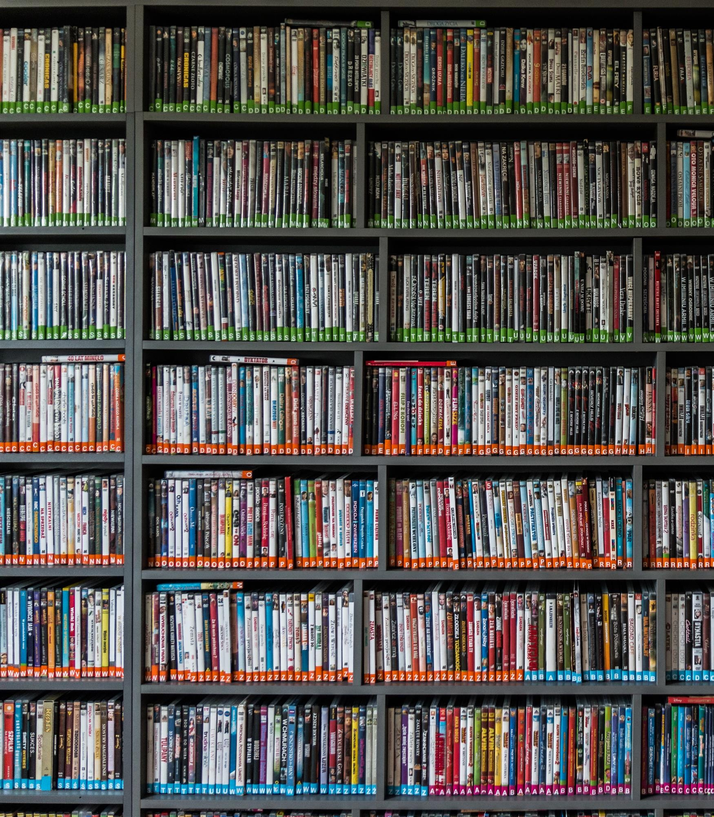
What do libraries need to consider to give access to physical media
Purchasing and cataloguing
Providing shelving space
Equipment for viewing films
Providing spaces to view
Providing services like scheduling movie screening times
Preservation
Copyright

Slide 7

Mel Hoppenheim
School of Cinema
Canada’s largest university-based centre for study of:
  Film Animation
  Film Production
  Film and Moving Image Studies
Faculty of Fine Arts, BFA, MFA, MA, PhD
Screening facilities:
  3 Cinemas + 1 seminar room with screening booths and projectionists
  Classrooms
Notes:
I’d like to begin by telling you a bit about the Mel Hoppenheim School of Cinema, part of Concordia’s Faculty of Fine Arts
It has an international reputation as a leader and is Canada’s largest university-based school for the study of cinematic arts.
It offers 3 programs: Film Animation, Film Production, and Film and moving image studies, and grants degrees ranging from Bachelors to PhDs.
Film screenings as a pedagogical practice are predominantly part of the Film and Moving Image Studies courses, and mostly take place in their cinemas and seminar room equipped with screening booths and projectionists. Of note, these high quality facilities sought after for film festivals such as Fantasia and Le FIFA (the International Festival of Films on Art).

Slide 8
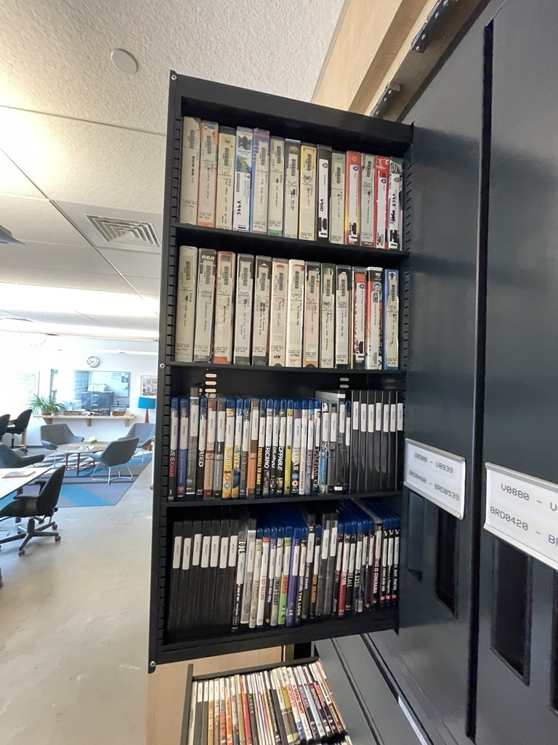
Visual Collections Repository (VCR)
Supports research and teaching by way of visual resources and media services
VCR is the home to:
  Moving Image Collection (est. 1968)
  Digital Images & Slides
  Celluloid Film Collection (11,500 historically significant 16mm and 35 mm films)
  Faculty and Student Work Collection
  Screening facilities (5 individual viewing stations, 1 mini-cinema, 1 seminar room)
VCR provides screening list management for in-class film screenings
Notes:
Supporting these screening activities and more is the Visual Collections Repository, affectionately referred to as the VCR.
The VCR hosts a number of collections including celluloid films, slides, and most relevant to our research, the teaching and research film collection known as the Moving Image Collection.
The VCR also have their own state of the art viewing facilities for individual and group screenings.
VCR provides vital service of screening list management for courses with in class screening

Slide 9

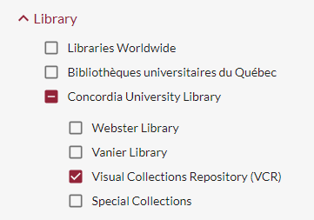
The VCR and the Library
2021
FoFA and Library agree to the transfer of the film collection to the Library, including responsibility for development, processing, cataloguing and making available of the VCR film collection.
2023
VCR’s Moving Image Collection in WorldCat Discovery/Sofia:
  15,600 physical items catalogued
    21,000 titles on DVD
    3,100 on Blu-ray discs (including 3D and UHD 4K)
    VHS tapes, laserdiscs, etc.
Notes:
In 2021 the Faculty of Fine Arts and Library agree to transfer the film collection to the library, specifically for acquisition, processing, cataloguing and circulation.
The films would continue to be located in the VCR.
What this meant was creating the collection in OCLC’s WorldShare Management Services or WMS using WorldCat bibliographic records.
Large scale cataloguing project ensued and over 15k items of various formats as part of their moving image teaching collection were catalogued by Summer 2023 and available in Concordia’s WorldCat Discovery instance.
(In Fall 2023 the next logical step for the collaboration between the Library and the VCR was to find a way to use WMS Circulation to assist in screening list management.)

Slide 10
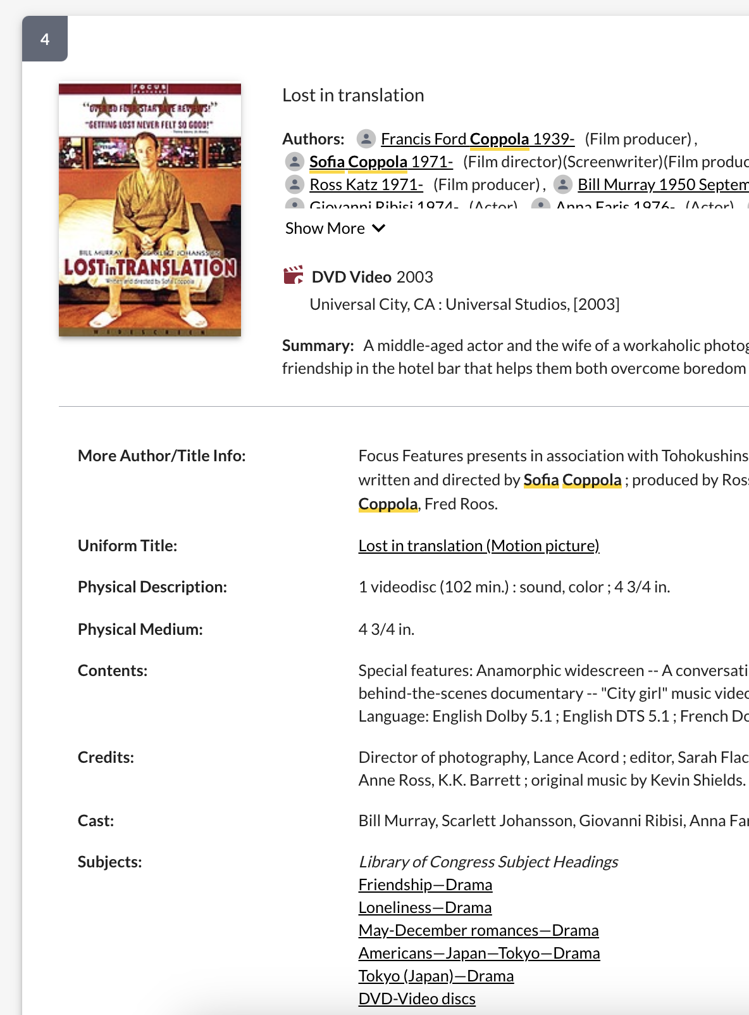
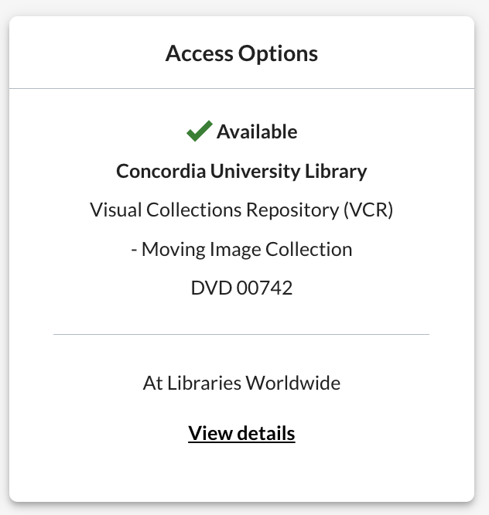
Circulation and Discovery now available!
Pre WMS (InMagic database):
  Records contain minimal metadata
  No circulation module
WMS:
  Sofia records offer richer information
  All items checked out to a user before leaving VCR
    Accurate status in Sofia
  Usage statistics
Notes:
Before transferring to the library, the original Moving Image Collection Database was an inmagic database, which allowed for limited metadata and could not handle circulation, so items circulated by exception only. This system had reached end of life.
By including the moving image collection into WMS, numerous advantages in both Discovery and Circulation:
Faculty marvel over the new, richer records
Discovery accurately represents the status of the item
Nothing leaves the VCR without being checked out to a user so we know where items should be.
Finally, with Circulation there will now be usage statistics for the items in the Moving image collection.

Slide 11

In-class screenings
Volume
700-860 screenings across ~30 courses per semester (12 weeks)
Complexity
Multiple screenings or compilations cause conflicts
Distributed
Screening booths are in 4 different buildings on the downtown campus
Time Sensitive
Material pulled on Wednesdays for the next week and sent to viewing rooms using tubs via Distribution Services either on Thursday evening or Friday morning
Material from the current week was returned as following week were delivered
Pre WMS: very complicated network of excel spreadsheets to know when and where an item needed to be for screening
Notes:
Back to in-class screenings for film studies courses.
The basic logistics are:
the 4 screening booths are located in 4 different buildings on the downtown campus.
There are upwards of 700 screenings over a 12 week period
Complexity of multiple screenings of same film, or of multiple titles on the same physical item, in the same week or consecutive weeks causes scheduling conflicts
Pulling material once a week on Wednesdays, which would be done by staff in VCR for the following week, and the previous week’s material was returned upon delivery of the next week.
Despite instructors having these lists available before the beginning of the semester, this workflow consisted of a complicated network of excel spreadsheets to keep tabs on what film was needed where and when.

Slide 12
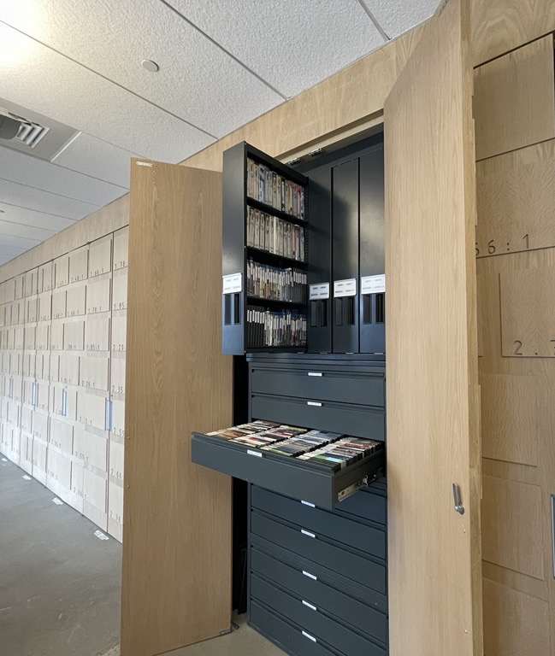
A new workflow
WMS workflow needed to achieve following goals:
Create a list of items to be pulled for a particular week
Identify conflicts
Easily obtain status of an item
Solution:
Create Screening booths as patrons
Place scheduled hold for item for the week it’s needed to generate timely pull lists
Scheduling work in WMS Circ would be undertaken by Clerk level staff in the Library (Webster) before the beginning of the semester
Timing of shipments remained the same
  To learn more see:
  OCLC WMS Connect Lightning Talk: Simplifying workflows -Scheduling items from the Visual Collections Repository
Notes:
In Fall 2023 the next logical step for the collaboration between the Library and the VCR was to find a way to use WMS Circulation to assist in screening list management.
Achieve following goals:
Create a list of items to be pulled for a particular week > this was the main goal when adopting the scheduling function in WMS
Identify conflicts, for example videos being screened during the same or consecutive weeks
Easily obtain status of an item as keeping track of where videos had been a constant challenge with the old workflow
Treating the screening booths as patrons regardless of the course or instructor that item was intended for and then scheduling holds for items so that they would end up on a pull list the right week.
This work would be undertaken by Clerk level staff in the Library (Webster) – experts in Circ, freeing up VCR staff.
Timing for shipments would be the same, including pulling videos once a week on Wednesdays, which would be done by staff in VCR for the following week
For more information on the scheduled hold configuration and how we managing conflicts, see other presentation.

Slide 13
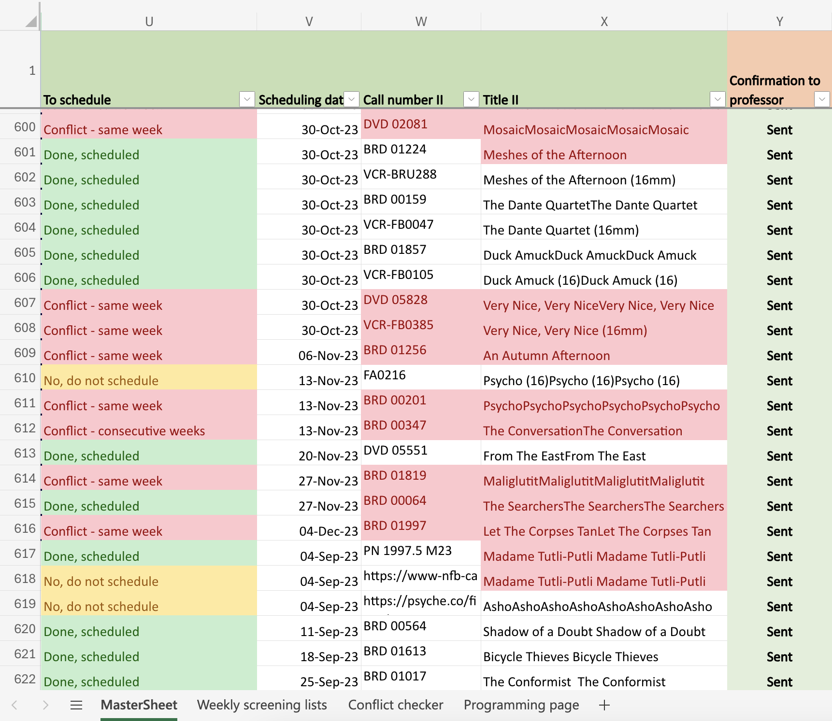
New workflow = improvements!
Spreadsheets used to validate Pull List because items that are still checked out will not appear (consecutive week conflicts)
Benefits
Patron Schedules List provides information about what is being screened and when
Item Schedules List provide information about whether the item has been scheduled, by whom and when, and whether there are any conflicts
Pull List and pop-up staff notes simplify the task of pulling videos
System more flexible when changes needed
Notes:
The excel spreadsheet remains an essential part of the workflow as info about screenings is compiled here. It is also used to flag issues for the VCR Coordinator, as staff can communicate via notes. And it’s also used to identify items to purchase and to create play lists for the projectionists.
Improvements:Via the WMS Circulation patron accounts for the viewing rooms, easy access to information about what is being screened when via the schedules list
Via WMS Circulation Discover search, quick access to information about whether a particular title has been scheduled, by whom and when, and whether there are any conflicts
Feedback from the VCR coordinator, who was managing the screenings before the new workflow, has been very positive. He described how this winter everything that could happen did happen, including student strikes:
Using the Pull List and pop-up staff notes made pulling videos more straightforward then creating lists from the spreadsheet which was more error prone
The VCR coordinator also appreciated that the System was flexible when changes were needed. He found it easy to modify a schedule when there were changes in timing of which there were many this semester

Slide 14
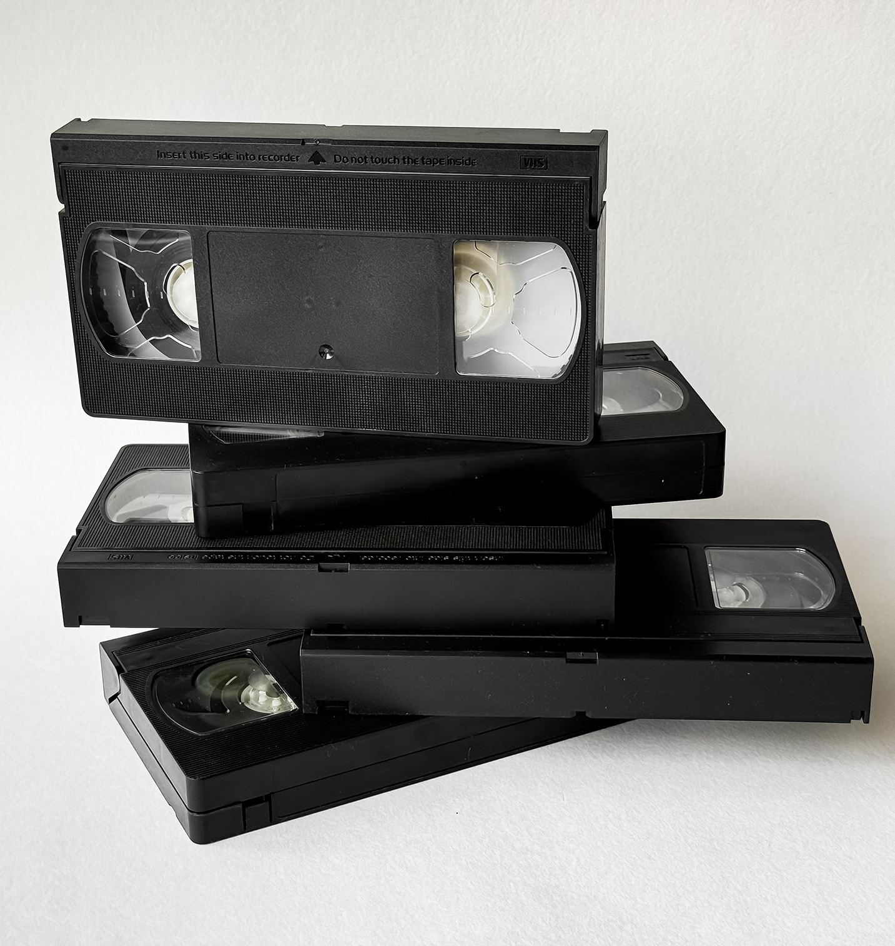
Screening statistics
4 semesters
129 courses
2922 requests from faculty
Average semester:
730 requests for film screenings
560 scheduled holds
14 new streaming acquisitions
52 new physical media acquisitions
Notes:
Two years in numbers
New items:
Over to Helene to dive a bit deeper into formats and our research

Slide 15
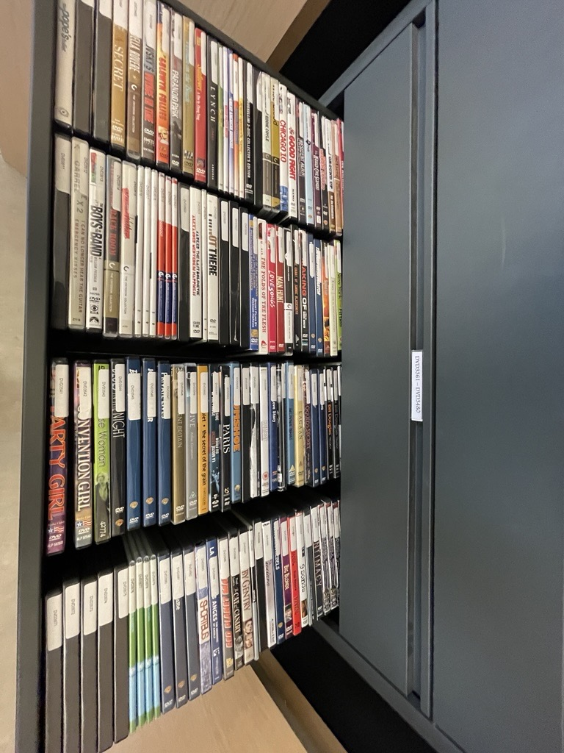
What we heard during the project from involved stakeholders
Film Analysis
Authenticity of the Experience
Formats & Teaching

Slide 16
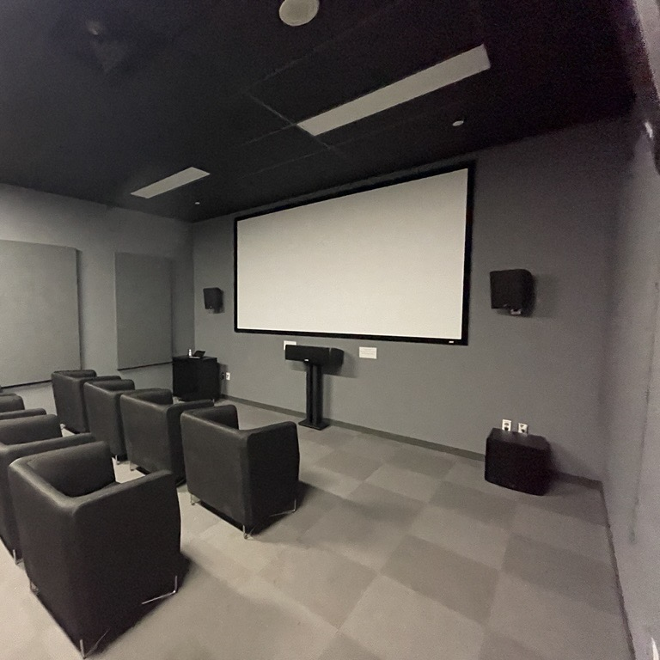
Film Analysis
High-Quality Image Resolution
Suitable for cinema quality and large screen projection
Flexible Navigation of Film Content
Cue specific scenes quickly
Jump seamlessly between clips
Comparative Viewing
Side-by-side analysis
Sound and musical score analysis
Capacity to isolate and analyze film sound design
Control Over Playback Speed & Timing
Slow-motion playback for precise movement or editing analysis
Perform shot-by-shot and even frame-by-frame analysis
2

Slide 17

Authenticity of the Screening
Visual Integrity
Films are presented in their original aspect ratio to maintain the director’s vision
Frame rate is preserved to avoid visual distortions (e.g., avoiding the "soap opera effect")
Audio Fidelity
Films are played with sound formats appropriate to their era and design:
  Mono (e.g., Breathless, 1960): single-channel, intimate, focused
  Stereo (e.g., The Godfather, 1972): directional
  Surround/Immersive (e.g., Dune, 2021): environmental depth and spatial realism
Cinematic Experience in the Cinema
Classes are held in professional cinema spaces, offering an authentic viewing environment.
A trained projectionist manages and operates all audiovisual elements to ensure technical fidelity
Viewing entire films allows instructors to shape the student experience by controlling:
  Screen size: preserving visual impact
  Ambient distractions: minimizing interruptions for focused engagement

Slide 18



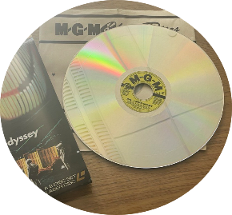
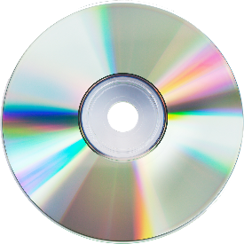
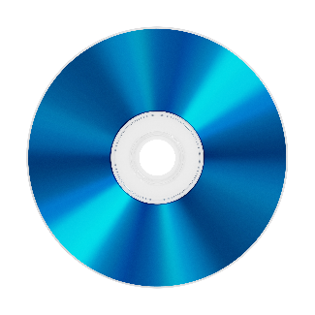
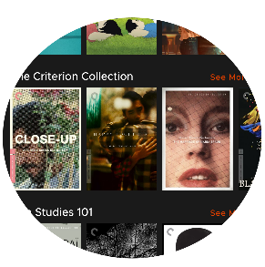
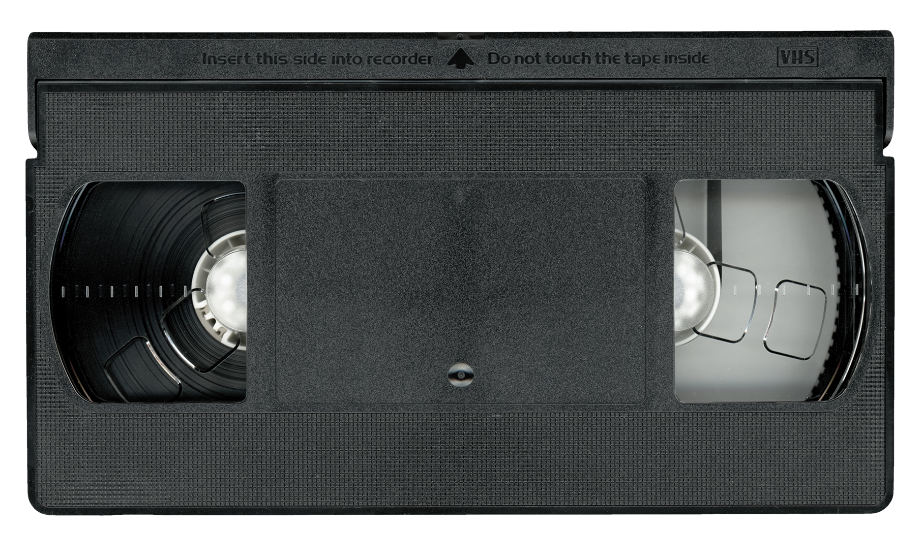
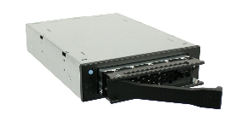
Formats & Teaching
35 MM
VHS
DVD
DCP
High quality Cannot
stop for frame-by-frame analysis
Lesser quality, not ideal for large screen projectors. Allows individuals to replicate analytical projector outside of class. Useful for film analysis exercises assigned outside of class.
Superior to VHS. Allows for exact queuing of sequences and shot-by-shot analysis.
Digital cinema package is a digital film print.
200 Mbits/second
Best digital quality available. Requires large storage capacity. Mainly used with film rentals and festivals.
16 MM
LASERDISC
BLU-RAY
STREAMING
Introduction of the analytical projector. Allows for frame-by-frame analysis.
Often used in parallel of 35 mm, one for high quality viewing, the other for scene analysis.
Image quality superior to VHS and DVD. Possible to do scene analysis. Disc must be turned mid-film.
40 Mbits/second
Best image quality after film. Allows for shot-by-shot analysis. Near but not frame-by-frame.
Quality variable but generally lower than DVD and Blu-ray. 5-8 Mbits/second
Audio options are limited. Often missing information on frame rate for proper projection. Subject to available internet bandwidth. Impossible to cue at specific timecode. 5-15 second jumps make shot-by-shot analysis difficult.
Notes:
The format of the resource and its requirements depends on the use needed: streaming is perfect for full viewing in a private viewing setting, for example a television, however it does not work well in a class context where an instructor needs to assess a specific scene.
A Digital Cinema Package (abbr. DCP) is a digital filmprint, with a special data format for picture and sound.

Slide 19
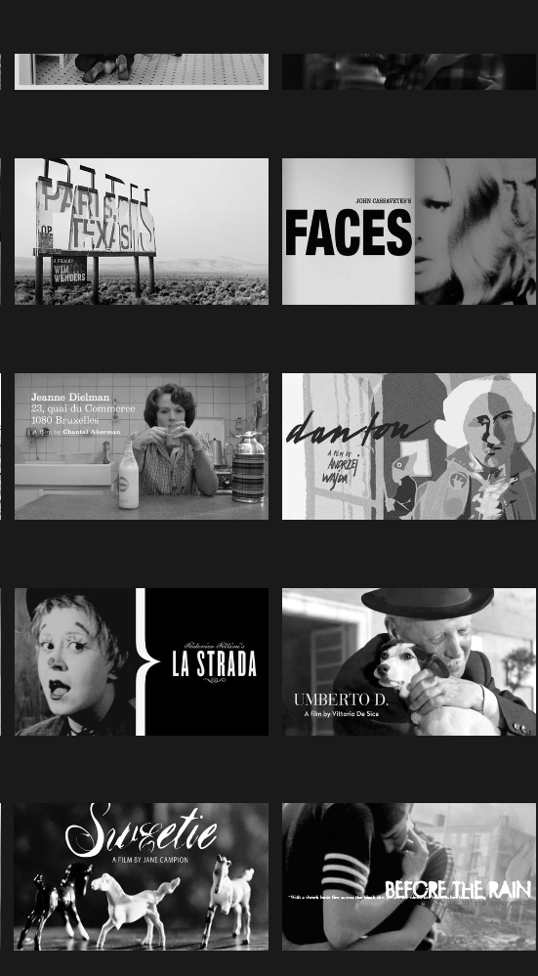
Next steps
With the initial information gathered throughout the collection migration project, the next phase involves developing a survey to systemize data collection both internally and externally.
Scope:
Who
  Professors teaching in Film Studies
  Librarians involved in audiovisual collection management and acquisitions
  Librarians responsible for audiovisual database subscriptions
Program
  Post-secondary institutions
  Presence of a film studies program

Slide 20
Next steps
Areas of Inquiry Being Explored:
For Librarians:
  Size and scope of audiovisual collections
  Formats preserved and in active use (e.g., DVD, Blu-ray, digital, film reels)
  Acquisition models and preferred formats
  Availability of on-site film viewing facilities (in library or special collections)
For Film Studies Professors:
  Preferred formats for teaching (e.g., DVD, Blu-ray, streaming, 16mm)
  How films are integrated into curriculum (clips vs. full features)
  Whether films are assigned for in-class or out-of-class viewing
  Use of consumer streaming platforms (e.g., Netflix, Apple TV) as mandatory resources

Slide 21
References and further reading
Benedetti, S., & Cross, J. G. (2024). A question of longevity: Ongoing value of documentary film in an academic library. Collection & Curation, 43(4), 105–110. https://doi.org/10.1108/CC-12-2023-0042
Costanzo, W. (1995). Teaching Film with Laserdiscs. Cinema Journal, 34(4), 78-83. https://www.jstor.org/stable/1225580
Fullmer, M. (2023). Future Proofing Streaming Video Acquisitions: A Medium Sized Academic Library Adapts. Technical Services Quarterly, 40(2), 59–75. https://doi.org/10.1080/07317131.2023.2187109
Hagener, M., & Kammerer, D. (2020). Streams are my reality. Der Online-Zugang zu Filmen aus Sicht der Filmwissenschaft. Bibliothek Forschung und Praxis, 44(3), 467–473. https://doi.org/10.1515/bfp-2020-2050 [translated using DeepL Translator]
Levenson, H. N., & Lombardo, S. V. (2023). The State of Streaming Video Content at Academic Libraries. Collection Management, 48(4), 397–408. https://doi.org/10.1080/01462679.2023.2255561
Proctor, J. (2018). Testing assumptions: Is streaming video really preferable to DVDs? Journal of Electronic Resources Librarianship, 30(2), 84–90. https://doi.org/10.1080/1941126X.2018.1465516
Rodgers, W. (2018). Buy, borrow, or steal? Film access for film studies students. College & Research Libraries, 79(4), 568.
Smith, C. (2024). Lack of Collections as Data: Making Meaning out of the Films We Cannot See. The Canadian Journal of Information and Library Science / La Revue Canadienne Des Sciences de l’information et de Bibliothéconomie, 47(3), 3–12. https://doi.org/10.5206/cjils-rcsib.v47i3.18988
Smith, C. F. (2022). Exploring Streaming Media and Course Reserves: A Case Study. Technical Services Quarterly, 39(3), 272–288. https://doi.org/10.1080/07317131.2022.2082661
Smith, C. F., Graham, R., & Revitt, E. (2024). Leaps in Media Access & Reuse: Copyright Codes of Best Practice. Proceedings of the Annual Conference of CAIS / Actes Du Congrès Annuel de l’ACSI. https://doi.org/10.29173/cais1988

Slide 22


